Slide 1

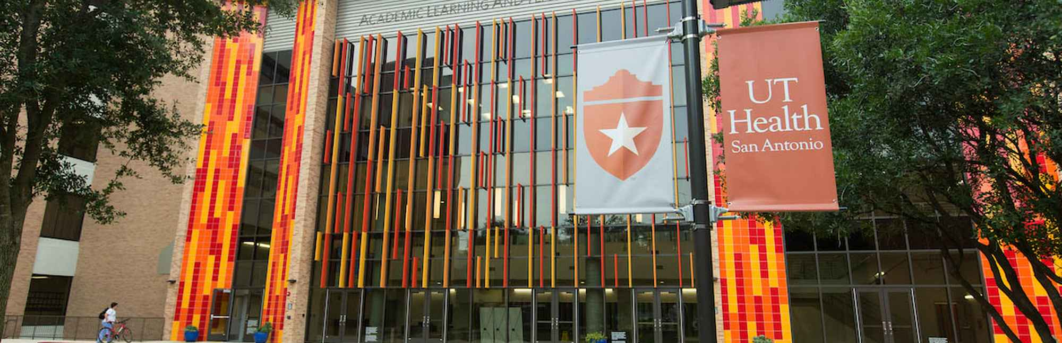
Explore Pharmacology:
Meet a Graduate Program – University of Texas Health Science Center at San Antonio
April Risinger PhD, Dept of Pharmacology
Today’s Focus
Sponsored Content by: University of Texas Health Science Center at San Antonio
Notes:
.

Slide 2

Ask questions in the chat
ASPET code of conduct
Session will be recorded
Housekeeping

Slide 3
After the Session:
Complete the survey
Recording available next week
Now - let’s get to know you!
Complete questions in the poll
Housekeeping

Slide 4
Annie Smelter, MD/PhD Candidate, UTHSA
Bridging Bench and Bedside: The Role of Physiology and Pharmacology in Translational Research
Jessie Alfaro, DDS/PhD Candidate, UTHSA
Expanding Your Horizons Through a Career as a Dentist-Scientist
Jacqueline Vazquez, PhD Candidate, UTHSA
What I Wish I Knew About a PhD in Physiology and Pharmacology: The Challenges and Opportunities Ahead
Gilbert “Drew” Pratt, PhD Candidate, UTHSA
From Combat Casualty Care to Integrated Biomedical Sciences: A Nontraditional PhD Path in Physiology & Pharmacology
Today’s
Speakers

Slide 5
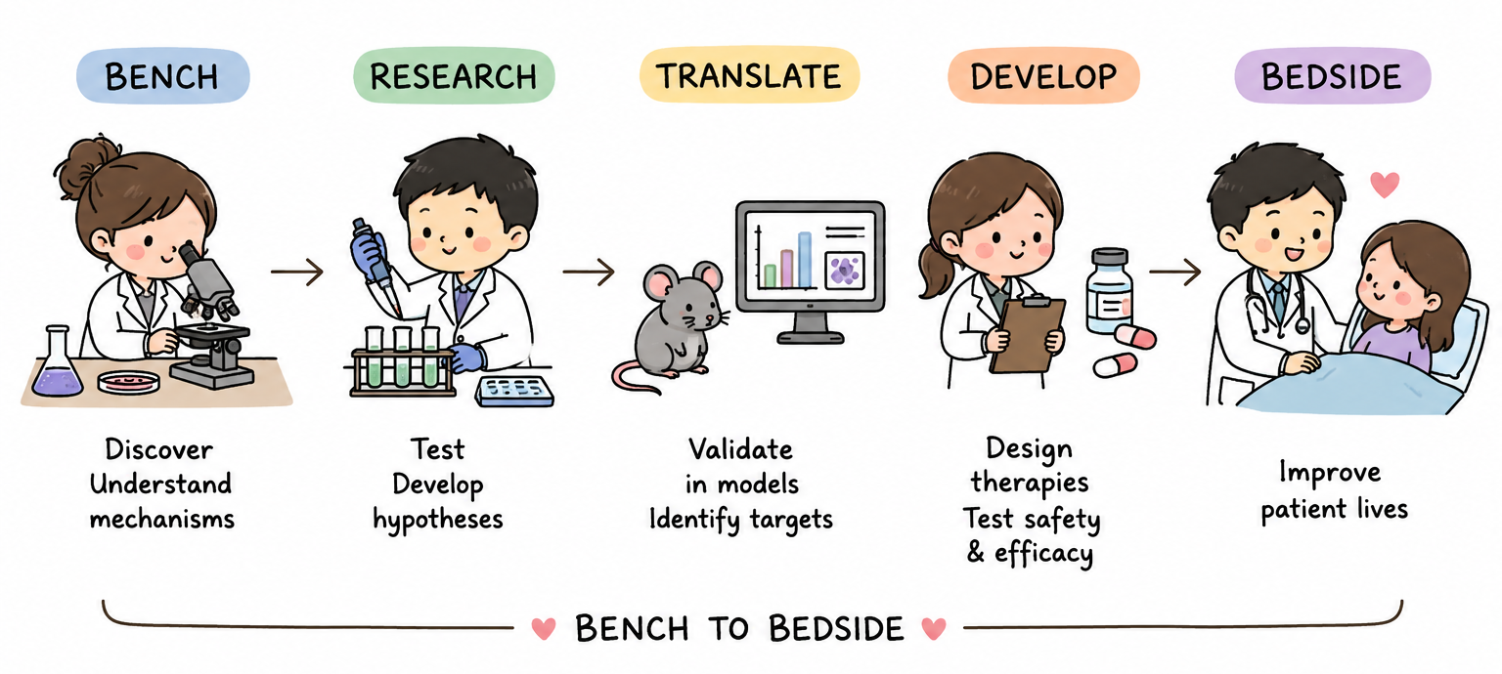

Bridging Bench and Bedside: The Role of Physiology and Pharmacology in Translational Research
Annie Smelter
MD/PhD candidate

Slide 6
Who am I?
Matriculated into South Texas Medical Scientist Training Program in 2022 at UTHSA – 2/4/2 structure
Joined the lab of Dr. Luke Norton in the Diabetes Division in 2024
  Liver physiology in health and disease; identifying therapeutic targets for obesity, Type 2 Diabetes, and metabolic liver disease
Chose Physiology & Pharmacology as my PhD discipline as a way to study disease mechanisms to ultimately improve patient care

Slide 7
Why Physiology and Pharmacology?
Physiology: the study of how living organisms function – from organ to molecular level
  Both in health and disease
Pharmacology: the research, discovery, and characterization of chemicals that interact with living systems
  Pharmacokinetics: what the body does to a drug/compound (absorption, distribution, metabolism, excretion)
  Pharmacodynamics: what the drug/compound does to the body (mechanism of action)
Broad application! Any disease can be studied this way!

Slide 8
Coursework in Physiology & Pharmacology
Principles of Physiology & Pharmacology
Fundamentals of Physiology
Drug Discovery and Development

Slide 9
How does P&P fit physician-scientists?
(or scientists motivated by translational research)
Mechanism-focused
  Learn to understand the system and disease of interest at a mechanistic level to better inform therapeutic targets
Broad applicability
  Cancer, cardiovascular disease, metabolism, neuroscience, immunology, rare diseases
  Beyond a discipline that only focuses on one particular system or disease
Clinical relevance
  Focus is always on human health and disease, and future therapies

Slide 10
My research as an example

Slide 11
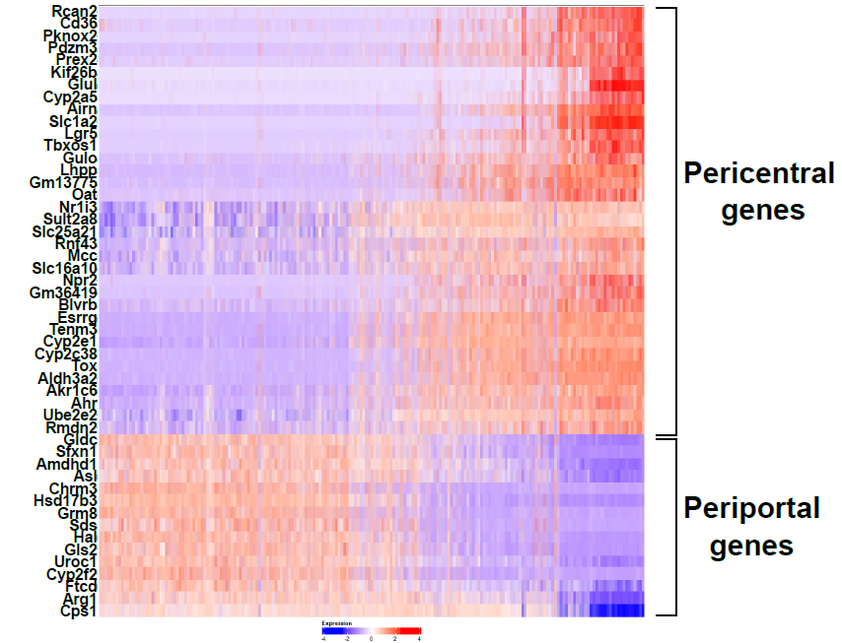
My research as an example

Slide 12
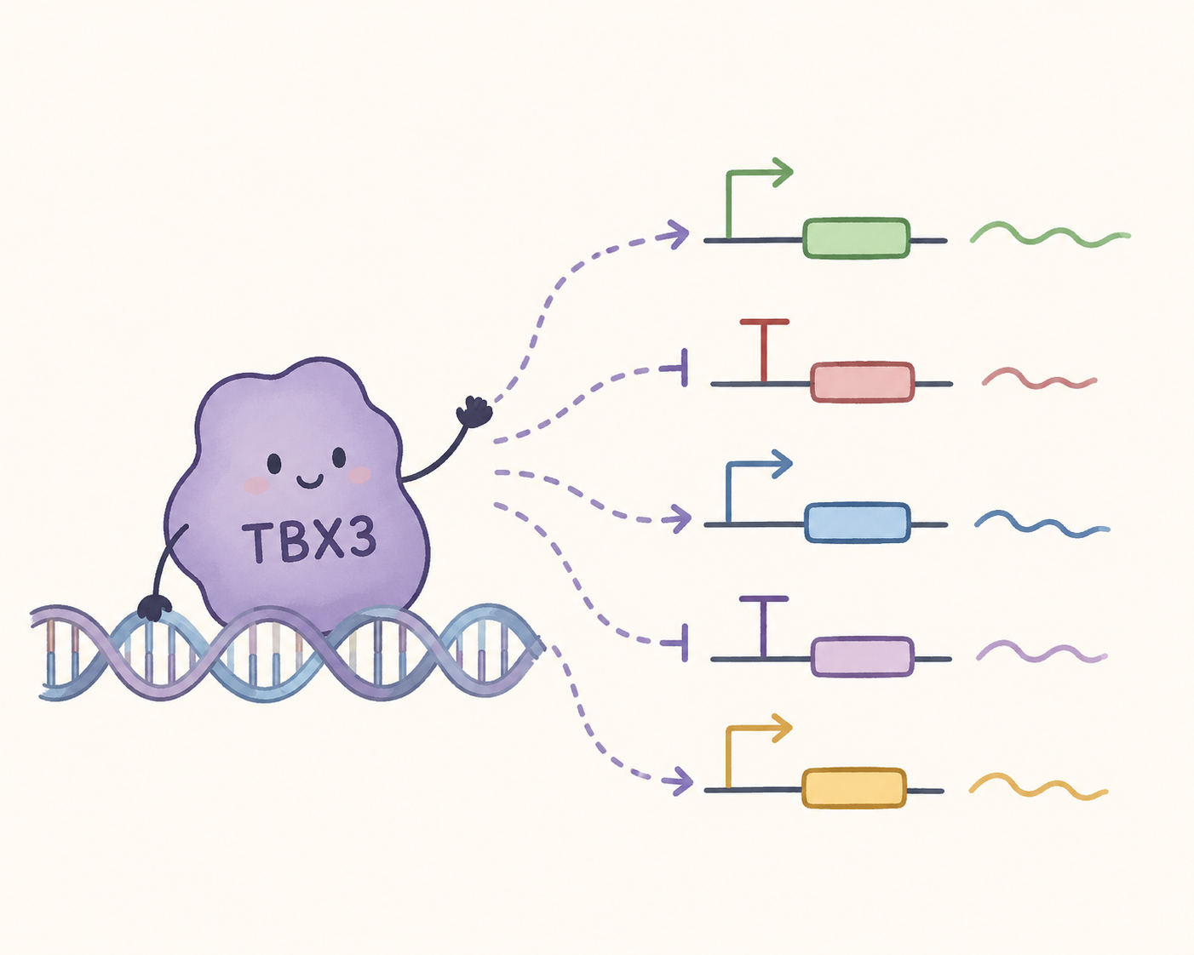
My research as an example

Slide 13
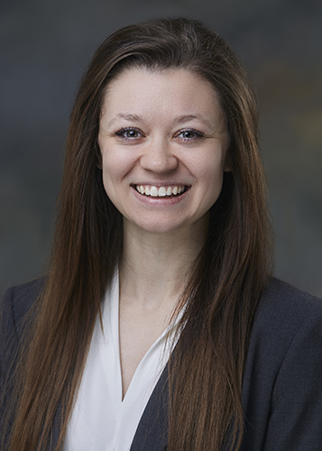

Summary
Ask mechanistic questions
Translate discoveries into therapies
Stay connected to patient care
Annie Smelter
smelter@livemail.uthscsa.edu

Slide 14
Expanding Your Horizons Through a Career as a Dentist-Scientist
Jessie J. Alfaro, 5th year DDS/PhD Student; Rising DS1
University of Texas at San Antonio, San Antonio, Tx.
Pharmacology & Physiology Discipline

Slide 15
UT Health San Antonio DDS/PhD Program
“The combined D.D.S./Ph.D. (Doctor of Dental Surgery and Doctor of
Philosophy) is a component of the Craniofacial Oral-Biology Student
Training in Academic Research (COSTAR) T32 Training Program, funded by the NIH. ”
Only 17 universities in the country have T32 programs
This national program focuses on creating the next generation of clinician scientists to ensure the future of the nation's oral health. You will become a clinician-scientist who can perform sponsored research in dental and craniofacial-related areas. Another goal of the program is to have our trainees become dental school faculty.

Slide 16
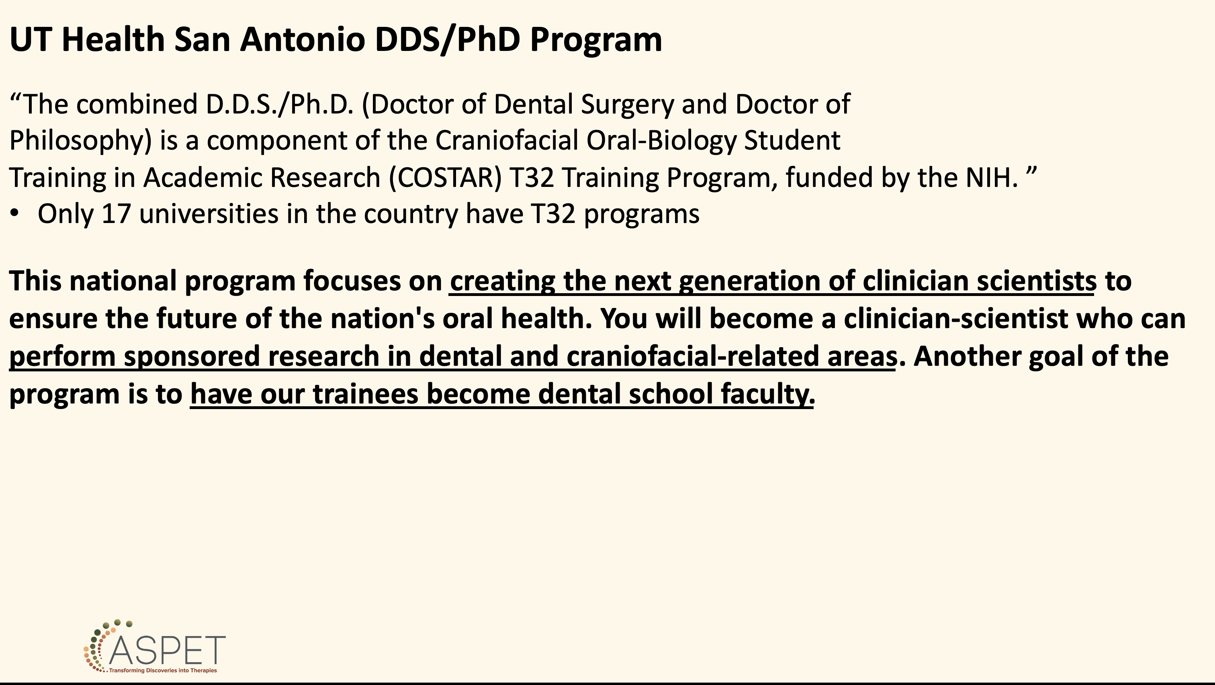
Motivation for Pursuing a Dual Degree (MD/PhD, DDS/PhD, PharmD/PhD, etc.)
“I want to become a clinician-scientist who advances dental patient care through research.”

Slide 17
UT Health San Antonio DDS/PhD Program
“The combined D.D.S./Ph.D. (Doctor of Dental Surgery and Doctor of
Philosophy) is a component of the Craniofacial Oral-Biology Student
Training in Academic Research (COSTAR) T32 Training Program, funded by the NIH. ”
Only 17 universities in the country have T32 programs
This national program focuses on creating the next generation of clinician scientists to ensure the future of the nation's oral health. You will become a clinician-scientist who can perform sponsored research in dental and craniofacial-related areas. Another goal of the program is to have our trainees become dental school faculty.
Admissions Process
Interview for the DDS program and gain acceptance
Interview for the COSTAR program and gain acceptance
Interview for the PhD program and gain acceptance

Slide 18
UT Health San Antonio DDS/PhD Program Format
Years 1-4 (sometimes 5, and rarely 3): PhD Training
Years 5-8: DDS Training & PhD Defense
Throughout the program, you receive:
Fully funded tuition
Graduate student stipend (currently $35k/year)

Slide 19
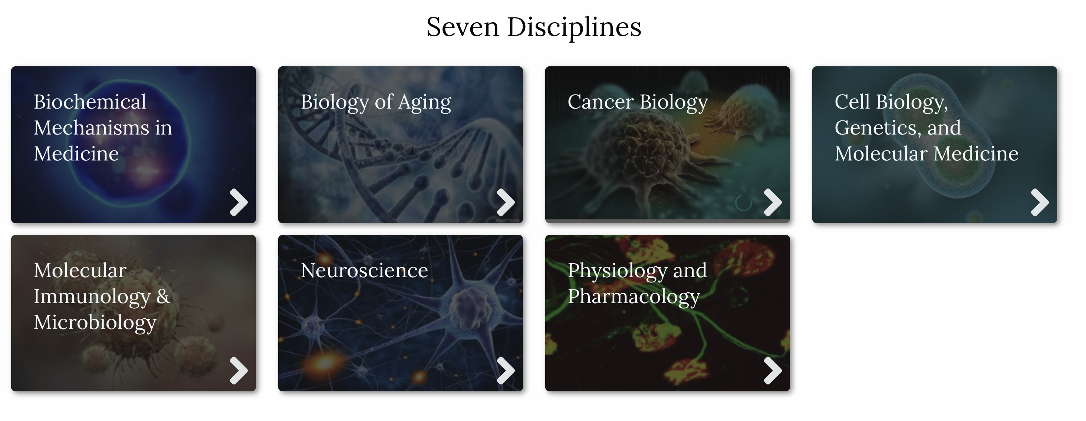
UT Health San Antonio DDS/PhD Program Format
Years 1-4 (sometimes 5, and rarely 3): PhD Training
Year 1
  Choosing a lab & discipline

Slide 20
UT Health San Antonio DDS/PhD Program Format
Years 1-4 (sometimes 5, and rarely 3): PhD Training
Year 1
  Choosing a lab & discipline

Slide 21
Pharmacology & Physiology Courses
Principles of Pharmacology & Physiology
Fundamentals of Physiology
Specific Problems in Pharmacology: Research Practicum
Drug Discovery & Development
Recurring Courses:
Physiology & Pharmacology Student Journal Clubs
Physiology & Pharmacology Seminars

Slide 22
Pharmacology & Physiology Dual Degree Careers
(MD-PhD, DDS-PhD, etc.)
Pharmaceutical Industry: Develop dental products (toothpaste, appliances, treatments, etc.)
Biotech: Conducting research and turning it into real-world solutions
Clinical Development Lead

Slide 23
Pharmacology & Physiology PhD Careers
Career | Description
Drug Discovery Scientist | Identifies new therapeutic targets and develops new drugs.
Clinical Pharmacologist | Studies how drugs behave in humans and helps optimize dosing and safety.
Medical Science Liaison (MSL) | Educates physicians and researchers about new therapies while working for pharmaceutical companies.
Clinical Development Scientist | Designs and oversees clinical trials for new therapeutics.

Slide 24
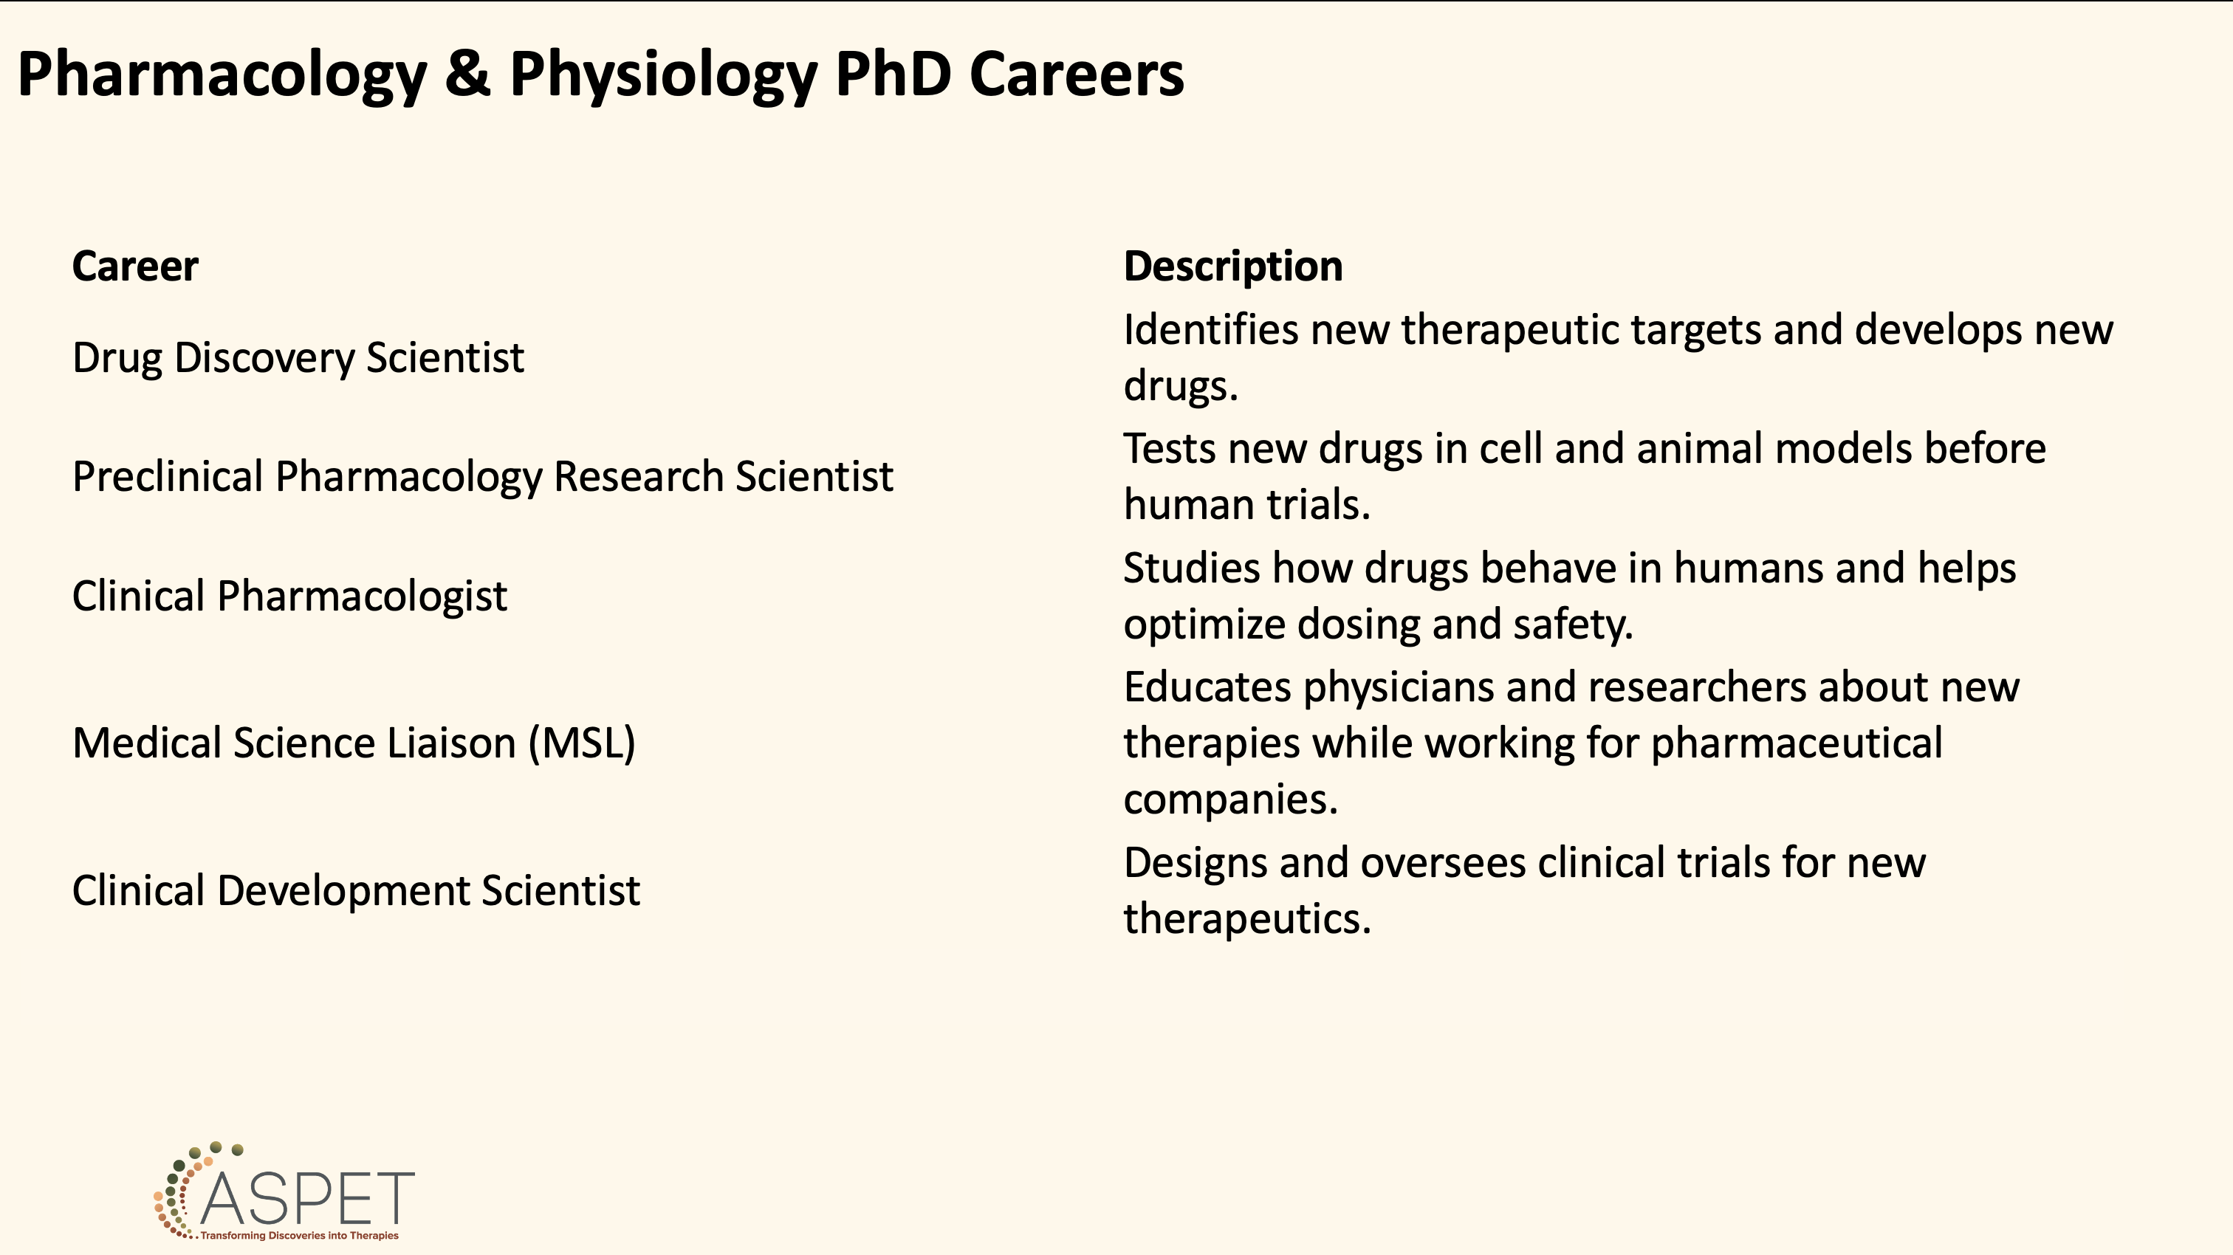
A background in Pharmacology & Physiology prepares you for unique opportunities since it provides a strong understanding of human physiology, disease mechanisms, and drug action

Slide 25
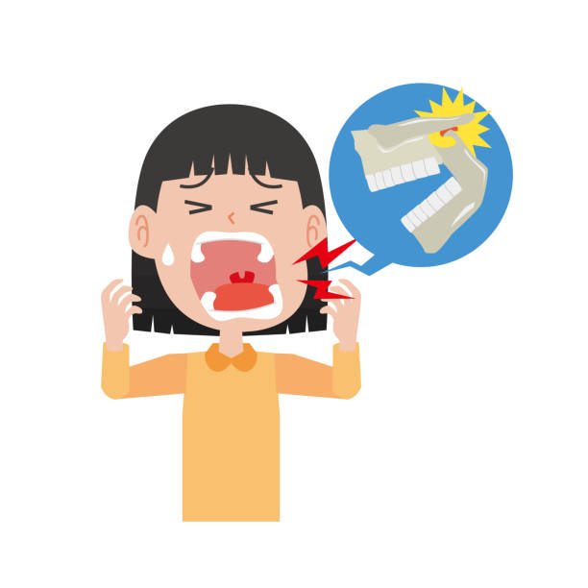
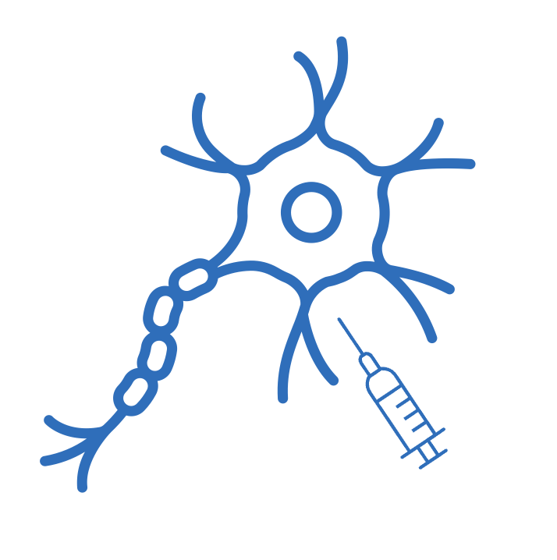
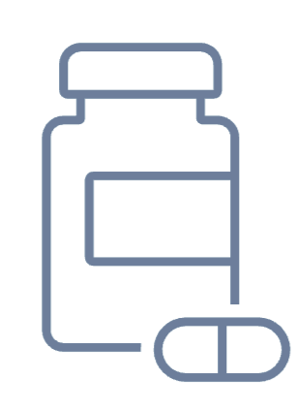
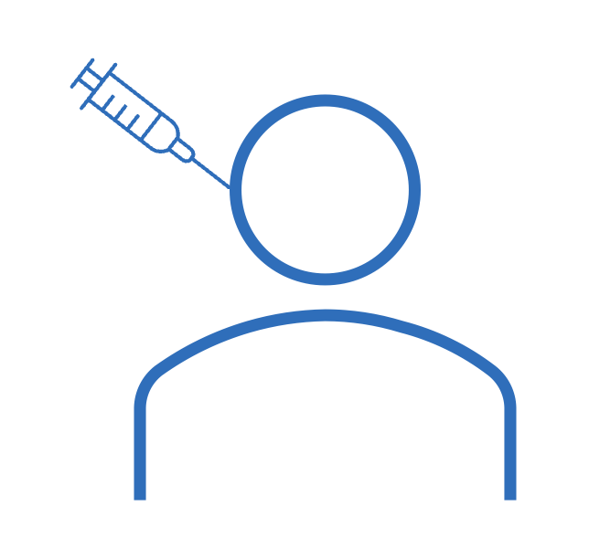
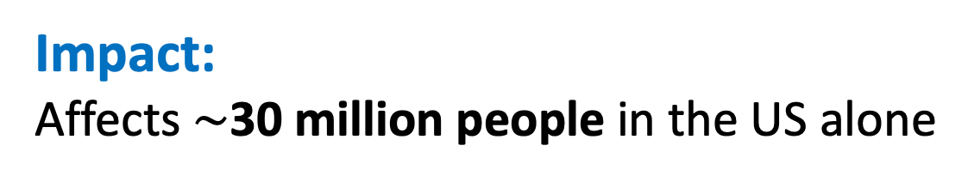
P&P and My Dissertation Research
Temporomandibular Joint Disorders (TMJD):
Conditions of the mastication system that affect the temporomandibular joint (TMJ), masticatory muscles, and ligaments
Impact:
Affects $\sim$30 million people in the US alone
Ineffective Treatment:
Opioids/NSAIDs
Botox/Steroids
Nerve Blockade
Goal:
Develop an effective TMJD pain treatment with minimal adverse side effects
istock.com

Slide 26
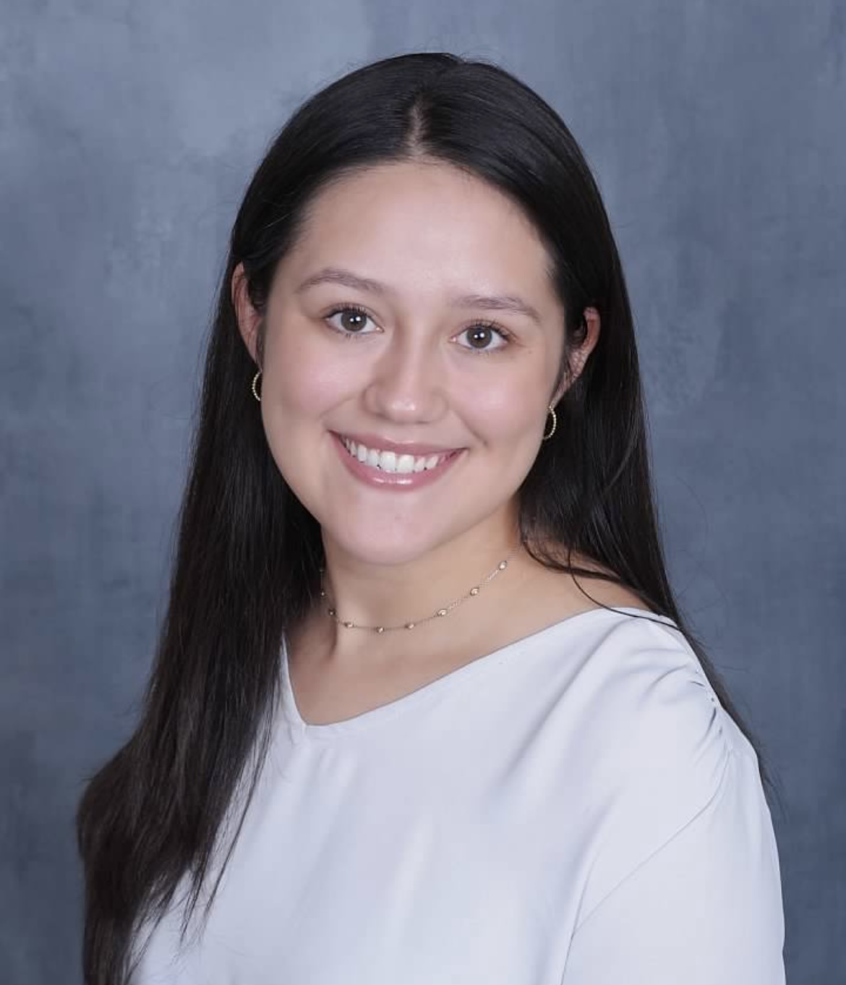

Thank you!
Feel free to contact me with any questions:
Jessie J. Alfaro, DDS/PhD Candidate
alfaroj@uthscsa.edu
"Research is to see what everybody else has seen, and to think what nobody else has thought.” - Albert Szent-Györgyi

Slide 27
What I Wish I Knew About a PhD in Physiology and Pharmacology: The Challenges and Opportunities Ahead
Jacqueline (Jackie) Vazquez
5th year Ph.D. Candidate
University of Texas Health San Antonio
Integrated Biomedical Sciences Program, Physiology & Pharmacology Discipline
Laboratories of Gregory Collins* and Brett Ginsburg
*Now at the University of Michigan

Slide 28


My Journey to a Ph.D.
Gained co-mentor (Brett Ginsburg),
learning new techniques
Passed QE on 2nd attempt
Research Assistant
Ph.D. in Integrated Biomedical Sciences,
Physiology & Pharmacology (P&P) Discipline
(Expected December 2026)
My lab (Gregory Collins) moved to the University of Michigan
B.S. in Behavioral Neuroscience (2021)
COVID-19
Failed qualifying exam (QE)

Slide 29
What Makes P&P Different?
Physiology & Pharmacology
Understand disease and treatment mechanisms
Drug discovery and development
Bridge basic science and clinical medicine
Physiology
How does the body normally function?
How do organ systems communicate?
What happens when normal physiology is disrupted?
Pharmacology
How do drugs interact with the body?
How can medications improve disease?
Why do some drugs produce unwanted effects?
My Research Example
Understanding how opioids and stimulants interact to influence behavior and physiology, with the goal of improving treatments for substance use disorders and overdoses.

Slide 30
Challenges Within a Ph.D. Program
Scientific Challenges
Experiments fail
Research takes longer than expected
Not every study has a clear answer
Personal Challenges
Imposter syndrome
Balancing work and life
Learning to handle criticism
Professional Challenges
Communicating science
Shifting research focus
Lab dynamics (least → most senior)

Slide 31
Opportunities Within our P&P Program
Scientific Opportunities
Experimental design
Personal Opportunities
Confidence and independence
Professional Opportunities
Conference presentations
Critical thinking (e.g., grant writing)
Data analysis
Networking
Leadership and mentoring
Time management
Scientific publications

Slide 32
A Ph.D. in Physiology & Pharmacology: Expectations vs. Reality
What I Expected
What I Learned
Mostly classes
Learning information
Clear answers
Individual work
Success = perfect results
Mostly research
Creating knowledge
Constant uncertainty
Team science
Success = interpreting findings
A Ph.D. isn't just about becoming an expert in physiology and pharmacology—it's about becoming a resilient problem solver.

Slide 33
Advice for Future Ph.D. Candidates in Physiology & Pharmacology
Find mentors early
Be curious - you don’t need all the answers
Failure is part of the process
Ask questions – even when it is intimidating
Focus on growth, not perfection
Build a support system
You will learn the tools necessary to investigate how drugs influence normal physiology and disease states.

Slide 34
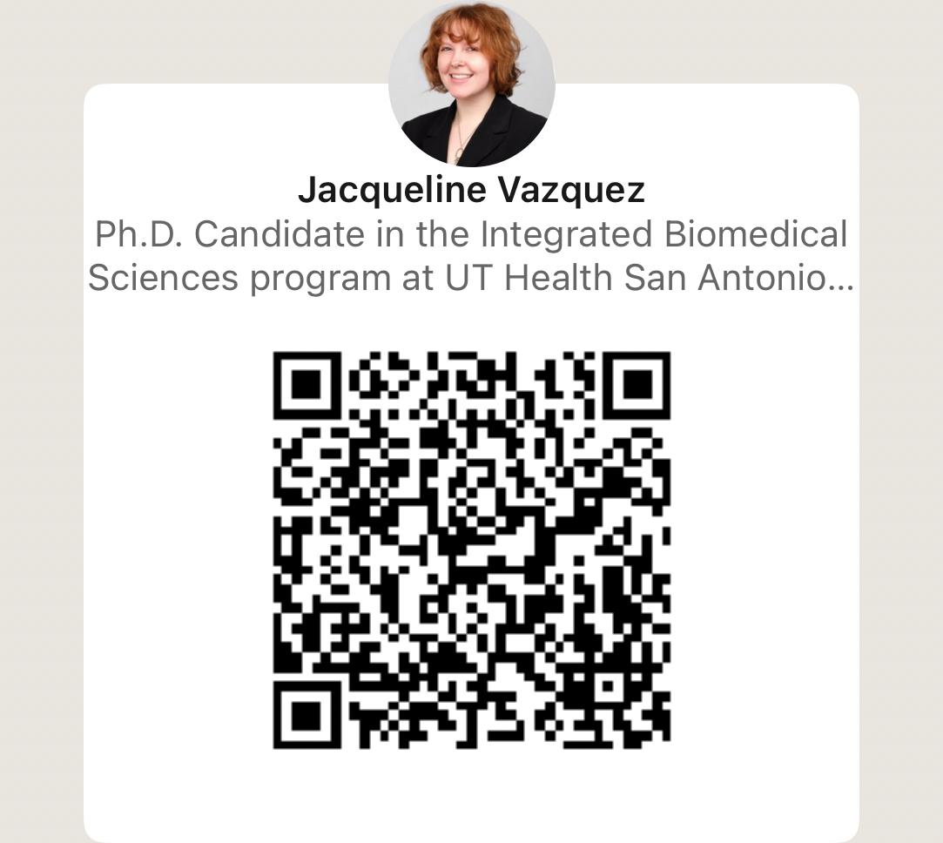
Contact Information
LinkedIn
Jacqueline (Jackie) Vazquez
Expected Defense: December 2026
vazquezj3@livemail.uthscsa.edu
Thank you for attending today!
You are one step closer to a Ph.D. in P&P
"What question could you spend a lifetime trying to answer?"

Slide 35
From Combat Casualty Care to Integrated Biomedical Sciences: A Nontraditional PhD Path in Physiology & Pharmacology
(Drew) Gilbert Andrew Pratt, III, MS
5th Year PhD Candidate
Laboratory of Susannah E. Nicholson, MD, MS, FACS
Division of Trauma and Emergency Surgery, Department of Surgery
UT Health San Antonio

Slide 36
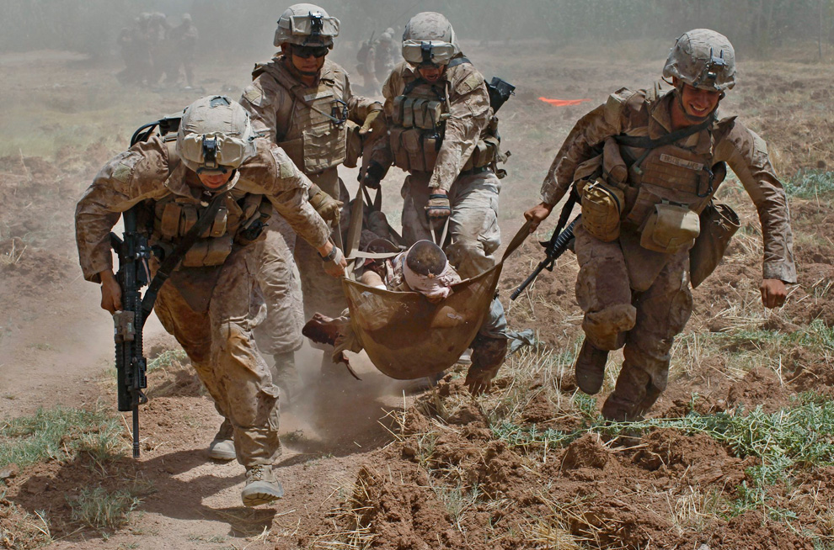
My Background
Marjah, Helmand Province, Afghanistan; U.S. Marine Corps IED casualty evacuation
Notes:
Prior to matriculating to UT Health, I was a Department of Defense contractor for the United States Navy at the Naval Medical Research Unit San Antonio. I worked as a Lab Manager in the Combat Casualty Care and Operational Medicine directorate and functioned as a hybrid lab manager, scientist, and safety officer for 7 years.
Focusing on RDT&E of medical devices and multi-functional resuscitative fluids to mitigate hemorrhage and ischemia/reperfusion injury of hemorrhagic shock.
In that time, I reached the pinnacle of what I could achieve as an investigator. To qualify for executive leadership positions, I needed a terminal degree. This led me to UT Health.

Slide 37
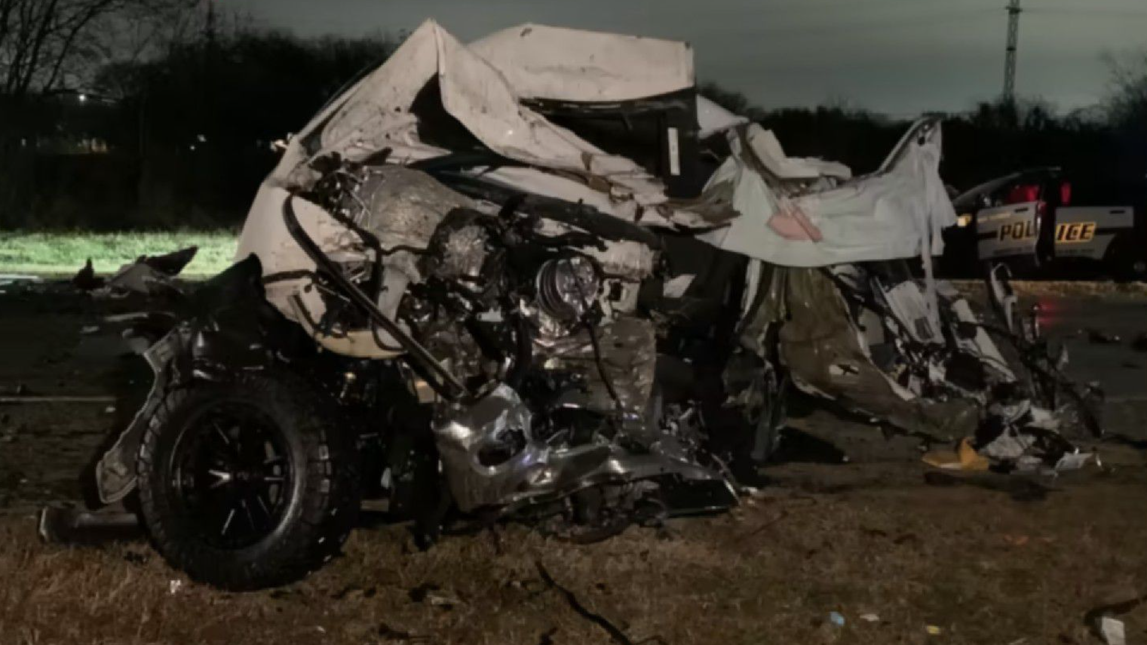
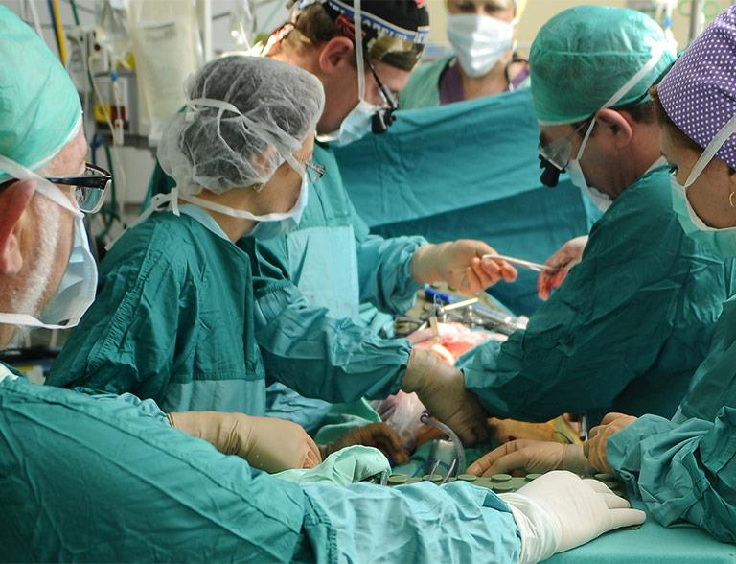
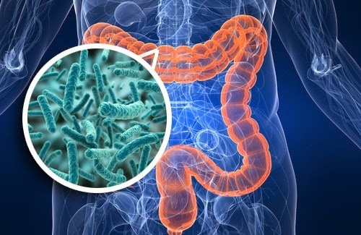
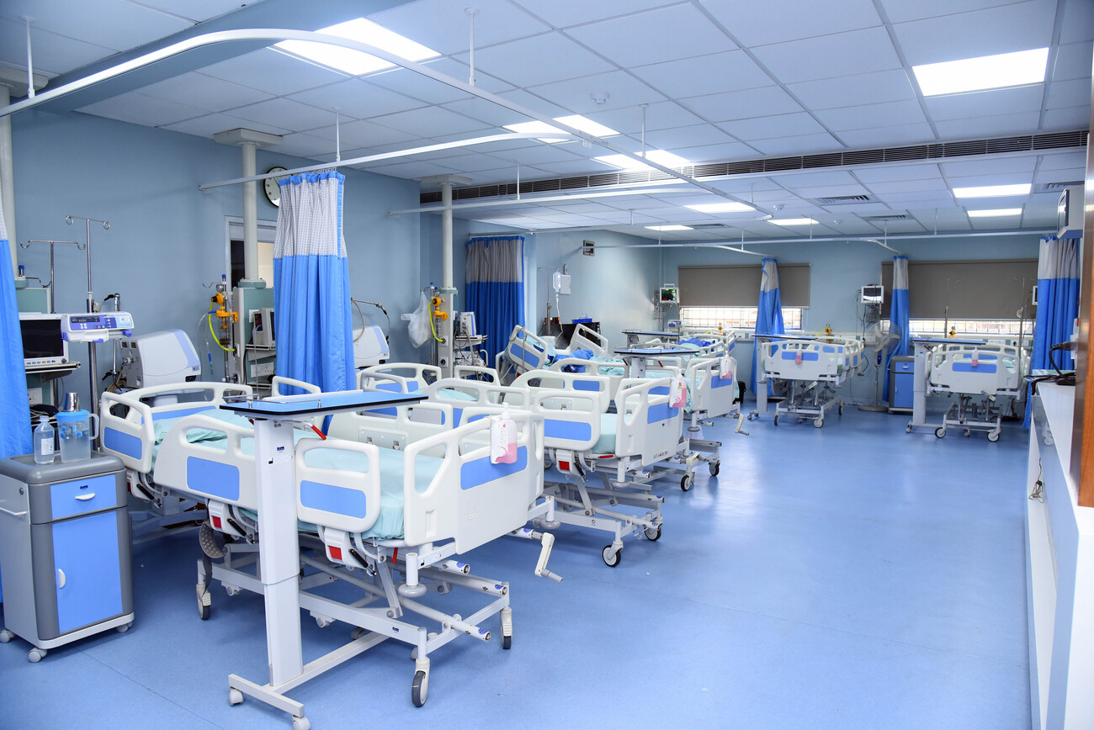
My Research Focus
Notes:
My research focuses on the gut microbiome-host-immune dynamics in polytraumatic injuries with hemorrhagic shock.
Uncontrolled hemorrhage and TBI are the leading causes of early death. MODS, coagulopathy and sepsis are the leading causes in the days to weeks after injury.
My focus is on the late deaths (days to weeks) we see in the ICU by characterizing the trauma induced microbiome, and its utility as a therapeutic target by microbiota transplant.

Slide 38
Why the Physiology & Pharmacology
Discipline?
P&P integrates whole-body physiology with molecular and therapeutic mechanisms
All the other disciplines within the IBMS program fit within a P&P framework
Strong emphasis on scientific writing, presenting, and grant development
Notes:
(CLICK) I think the P&P discipline really reflects the spirit of the IBMS program and it is demonstrated by the systems integrated approach in our core classes.
Neurobiology, aging, cancer, immunology, microbiology, genetics, and structural biology all fit within the P&P framework. Because of that, I think our discipline provides a wholistic approach in our training.
If nothing else, the Basics of Research Design course led by Dr. Charles France would be my #1 reason to select this discipline over the others in this program.

Slide 39
Why I Selected the Physiology &
Pharmacology Discipline
Development of novel therapeutic strategies for injured patients
Discipline Specific Core Curriculum:
Principles of Pharmacology
Drug Discovery and Development
Notes:
The goal of my research is to develop novel therapeutic strategies to serve as adjuncts to current clinical standards of care. To me, no other discipline seemed feasible to directly support that. (CLICK)
The core curriculum especially the Principles of Pharmacology and Drug Discovery and Development, helped me to better understand that at its most reductionist form, pharmacology examines how endogenous and exogenous ligands interact with biological targets to alter physiological function. Those effects are determined by dose, time, and system context.
I feel those foundations are fundamental to not only interpreting data, but also in the development of experimental models

Slide 40
My Recommendations for Graduate
School
Have an open mind when going through the coursework
Mentor Selection > Area of Research Focus
Mistakes are NOT failures, they are opportunities for growth
Notes:
Something else may ignite your passion. Remember, you will be locked into a specific area of research for 4+ years, make sure it is something you are driven to do, it helps keep you leveled during the ups and downs of the program.
Select labs that have a good infrastructure, funding, and personnel (e.g., senior lab techs and/or post-docs). Of those labs, determine which culture and values align best with you.
Wherever you end up, do not be afraid of making mistakes, they are not failures. You are going to make mistakes, and it is an important part of the learning process. Learn from them and you will grow as both a person and as a scientist.

Slide 41
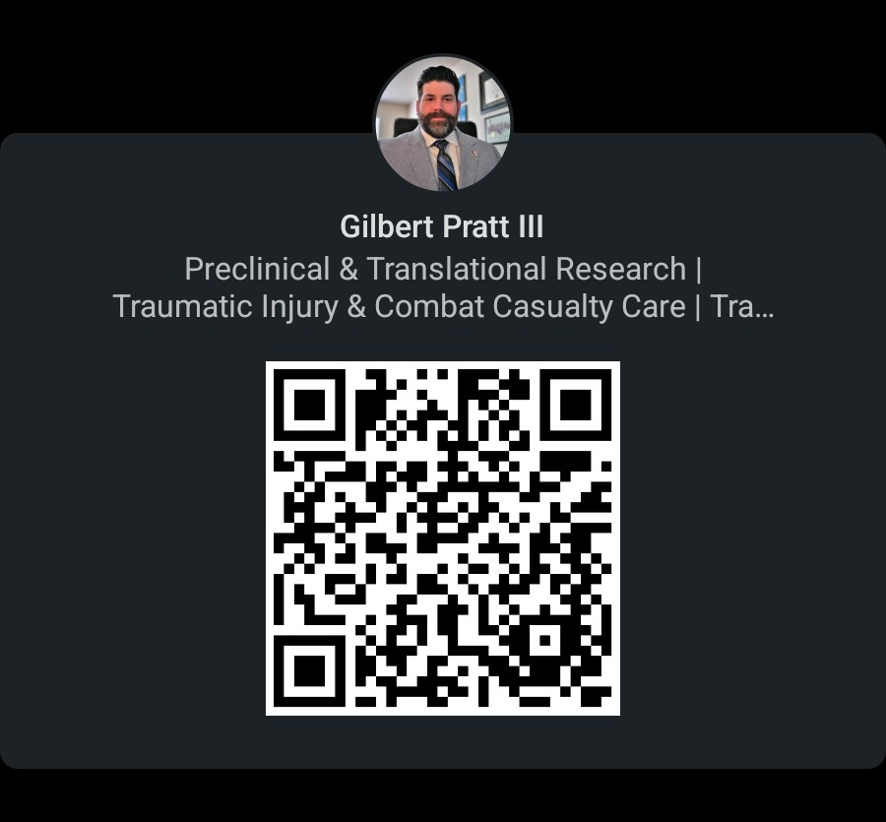

Contact Info
(Drew) Gilbert Pratt III
Expected Defense: Fall 2027
prattg@livemail.uthscsa.edu

Slide 42
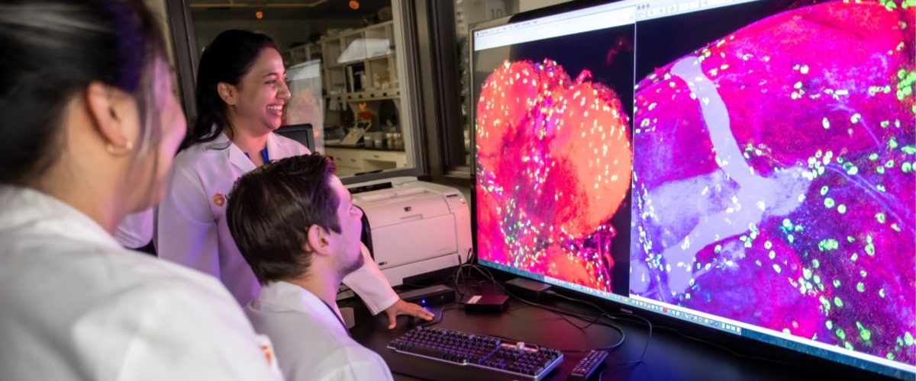
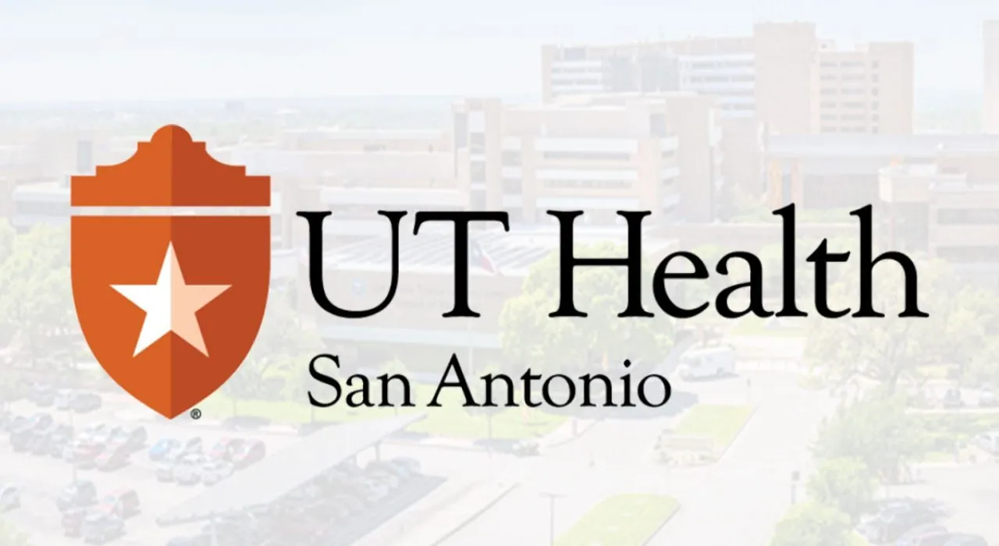
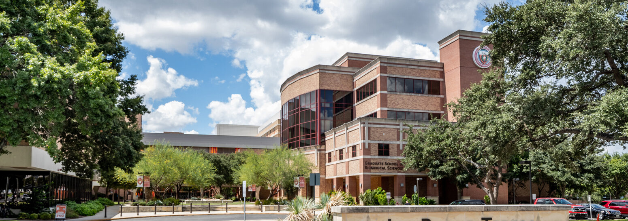
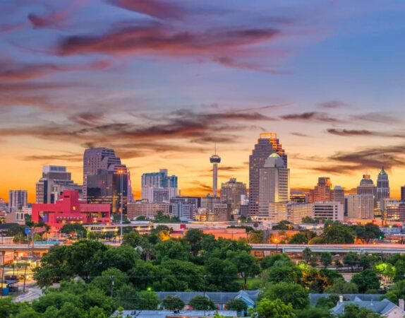
Thanks Annie, Jessie, Jackie, and Drew!
Q&A: Please put questions in the chat or raise your hand to ask a question
Applications open from Sept 1st – Dec 1st
https://uthscsa.edu/biomedical-sciences/programs/integrated/admissions

Slide 43
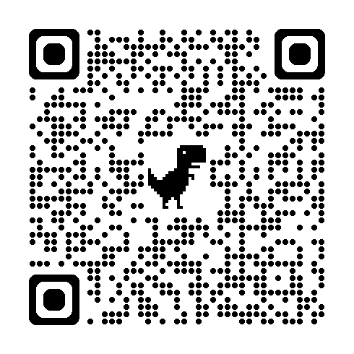
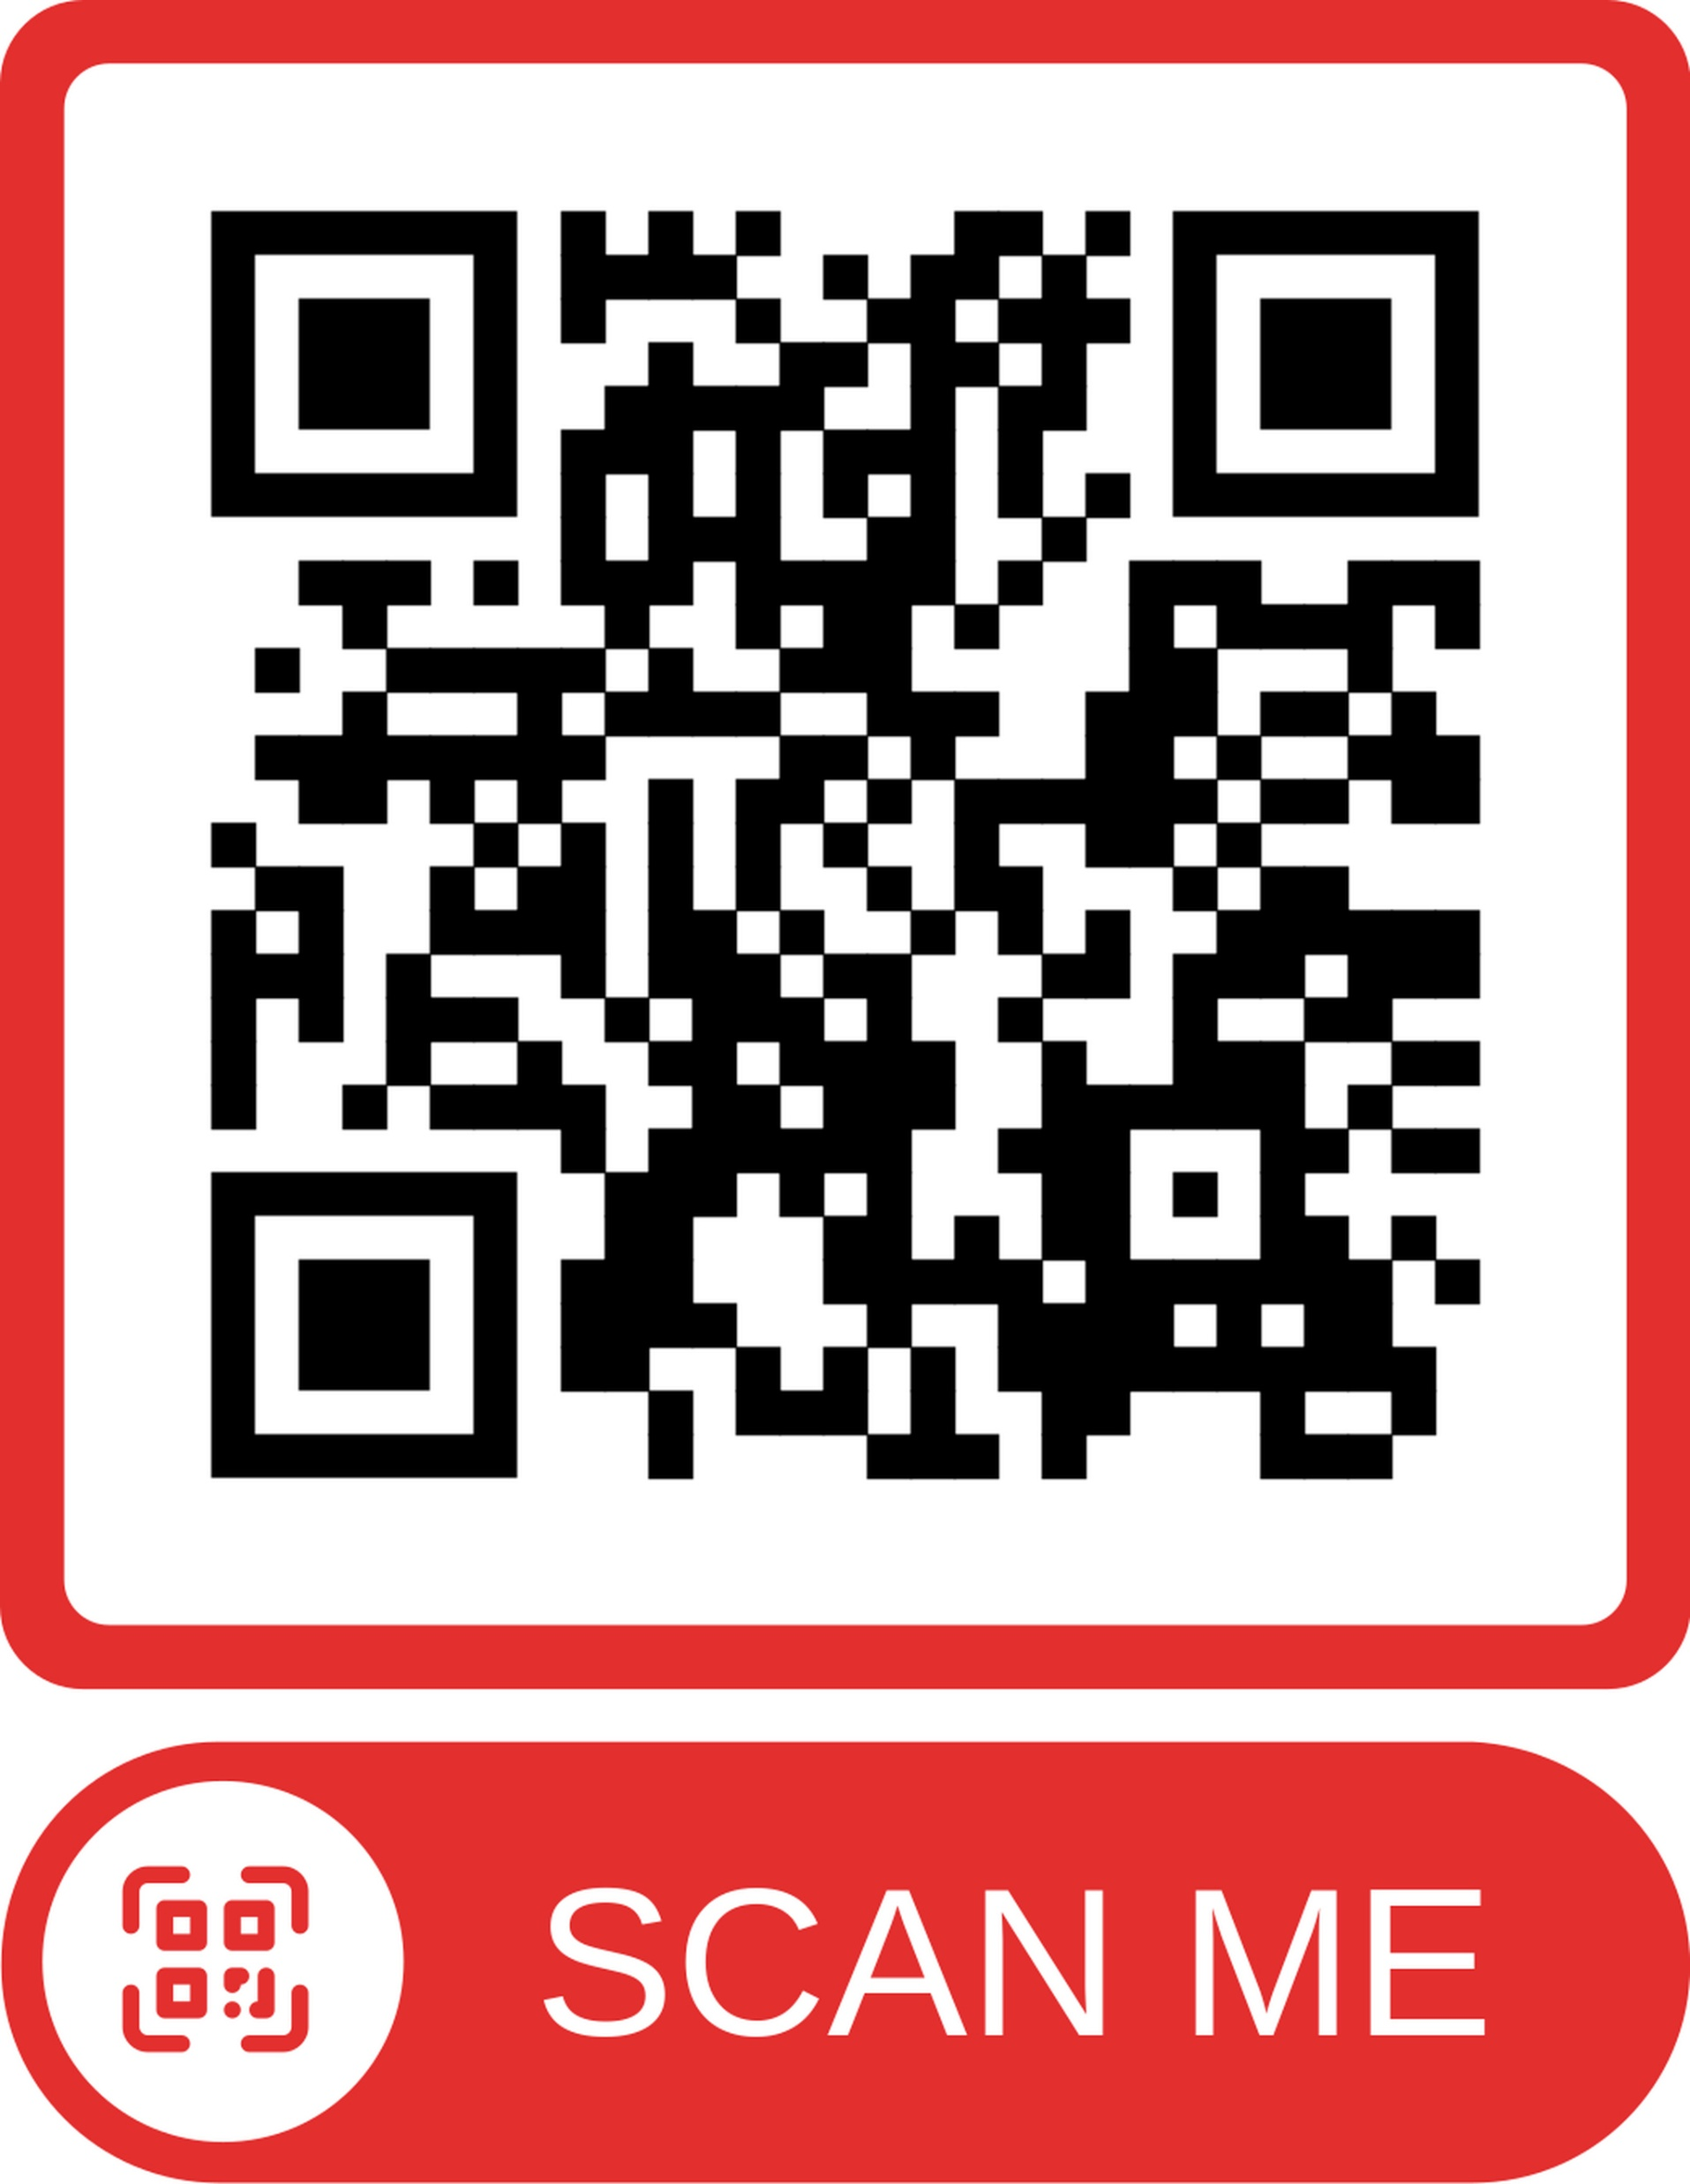
Please complete our survey (link in chat)
Thank You
Use code FOCUS26 for 30% off membership!
Submit a Session Proposal Today

